Slide 1












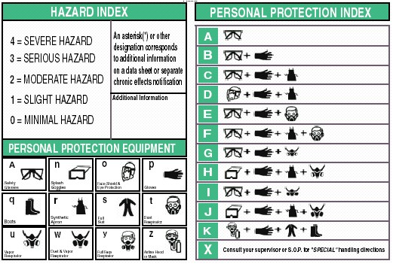
GHS Label detailed instructions
Global GHS Label danger icon for the background: white Symbol: Black Border: Red
Causticity
Causes severe skin burns and eye burns
May be corrosive to metals
Pressurized gas
Contains gas under pressure; may explode if heated
Contains refrigerated gas; may cryogenic burns
Explosive
Fire, blast or projection hazard
May mass explode in fire
Unstable explosives
May explode if heated
Environmental pollution
Fatal in contact with skin
Toxic in contact with skin
Fatal if swallowed. Inhalation Fatal
Toxic if swallowed. Inhalation of toxic
May cause fire or explosion; strong oxidants
May intensify fire or explosion; strong oxidants
Toxic in contact with skin
Ingestion, inhalation, skin contact with harmful
May cause skin and eye irritation or allergy
May cause respiratory irritation or may cause drowsiness or dizziness
May cause cancer, may cause genetic defects
Long-term or repeated exposure may cause damage to organs
May damage fertility or the unborn child
Inhalation or ingestion may cause allergy or asthma symptoms or breathing difficulties, severe fatal
Overheating may cause a fire
Or extremely flammable gases
Flammable plastic, flammable solids
Flammable liquid and vapor
Fire spontaneously if exposed to air
Water, emit flammable gases may spontaneous combustion or a
Volume may be self-heating or spontaneous combustion when possible
No data impact
Harmless
At present we lack information GHS Label radiation may increase in the future
0,1,2,3,4 five levels affect the health of 0 is no effect, 4 are seriously affected
Ignition points 0,1,2,3,4 five levels 0 is no effect, four are seriously affected
The reaction of 0,1,2,3,4 five levels 0 is no effect 4 is severely affected
HEALTH | 1
FLAMMABILITY | 1
REACTIVITY | 0
PERSONAL PROTECTION | C
Tristar Aero Technology, Inc. www.ghstag.com

